Slide 1

HOTEL AGGREGATION ANALYSIS

Slide 2
Objectives
Geographical Insights:
Visualize the distribution of listings on a map to identify popular neighborhoods.
Pricing and Availability Analysis:
Analyze pricing trends based on property types, room types, and accommodation capacity.
Host Performance:
Evaluate host characteristics, including superhost status, response times, and verification methods.
Review Scores and Guest Satisfaction:
Examine review scores and their impact on overall listing performance.
Property Type and Room Analysis:
Analyse the distribution of property types and room types.

Slide 3
Dataset Description
ID: Unique identifier for each listing.
Listing url: URL of the listing on the hotel aggregator platform.
Scrape id: Identifier for the data scraping event.
Last scraped: Date of the last data scrape.
Source: Source of the listing information.
Name: Name of the listing.
Description: Description of the listing.
Neighborhood overview: Overview of the neighborhood where the listing is located.
Picture url: URL of the listing's picture.
Host id: Unique identifier for the host.
Many more columns capturing details about hosts, location, property type, room details, amenities, pricing, availability, reviews, and other relevant information.

Slide 4
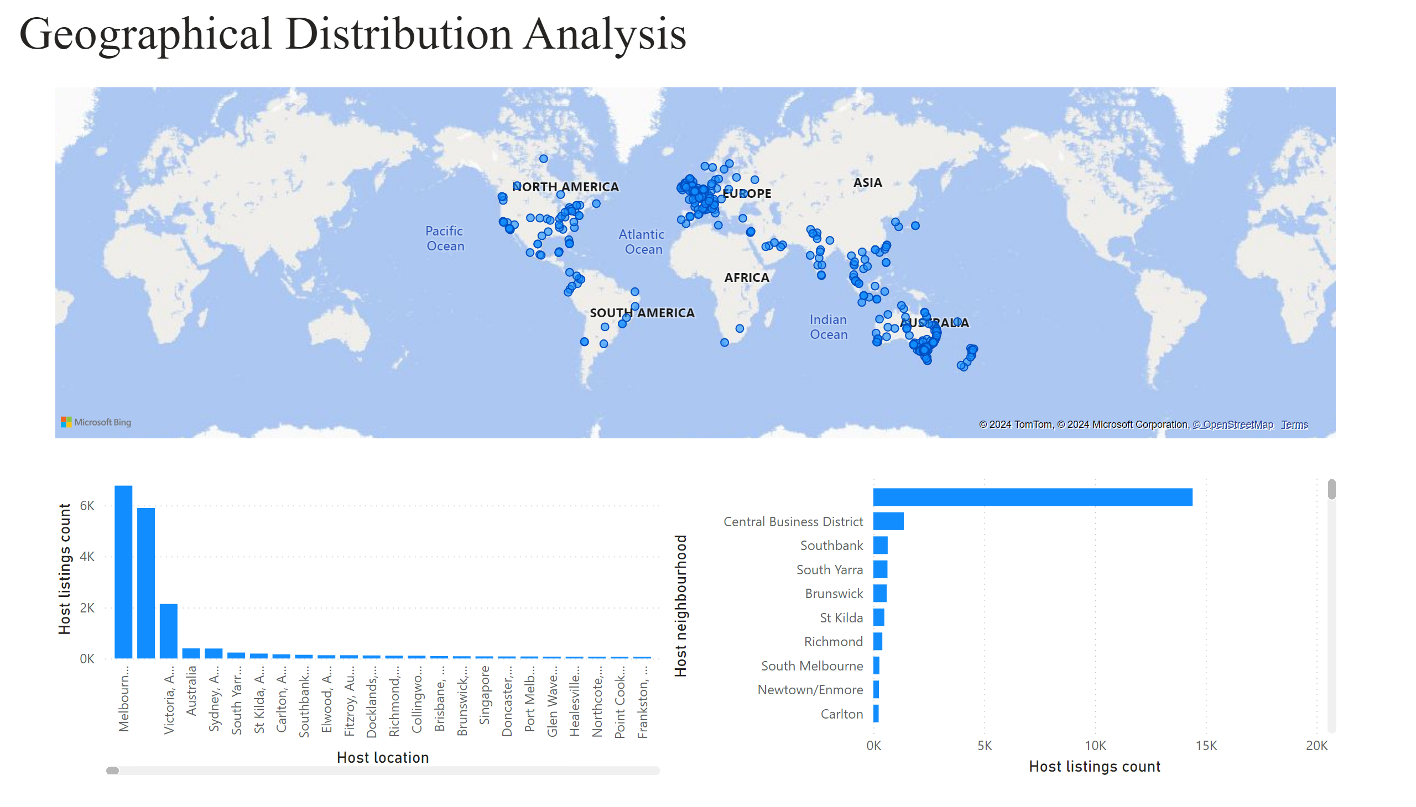
Page 1
Notes:
map
No alt text provided
columnChart
No alt text provided
textbox
No alt text provided
clusteredBarChart
No alt text provided

Slide 5
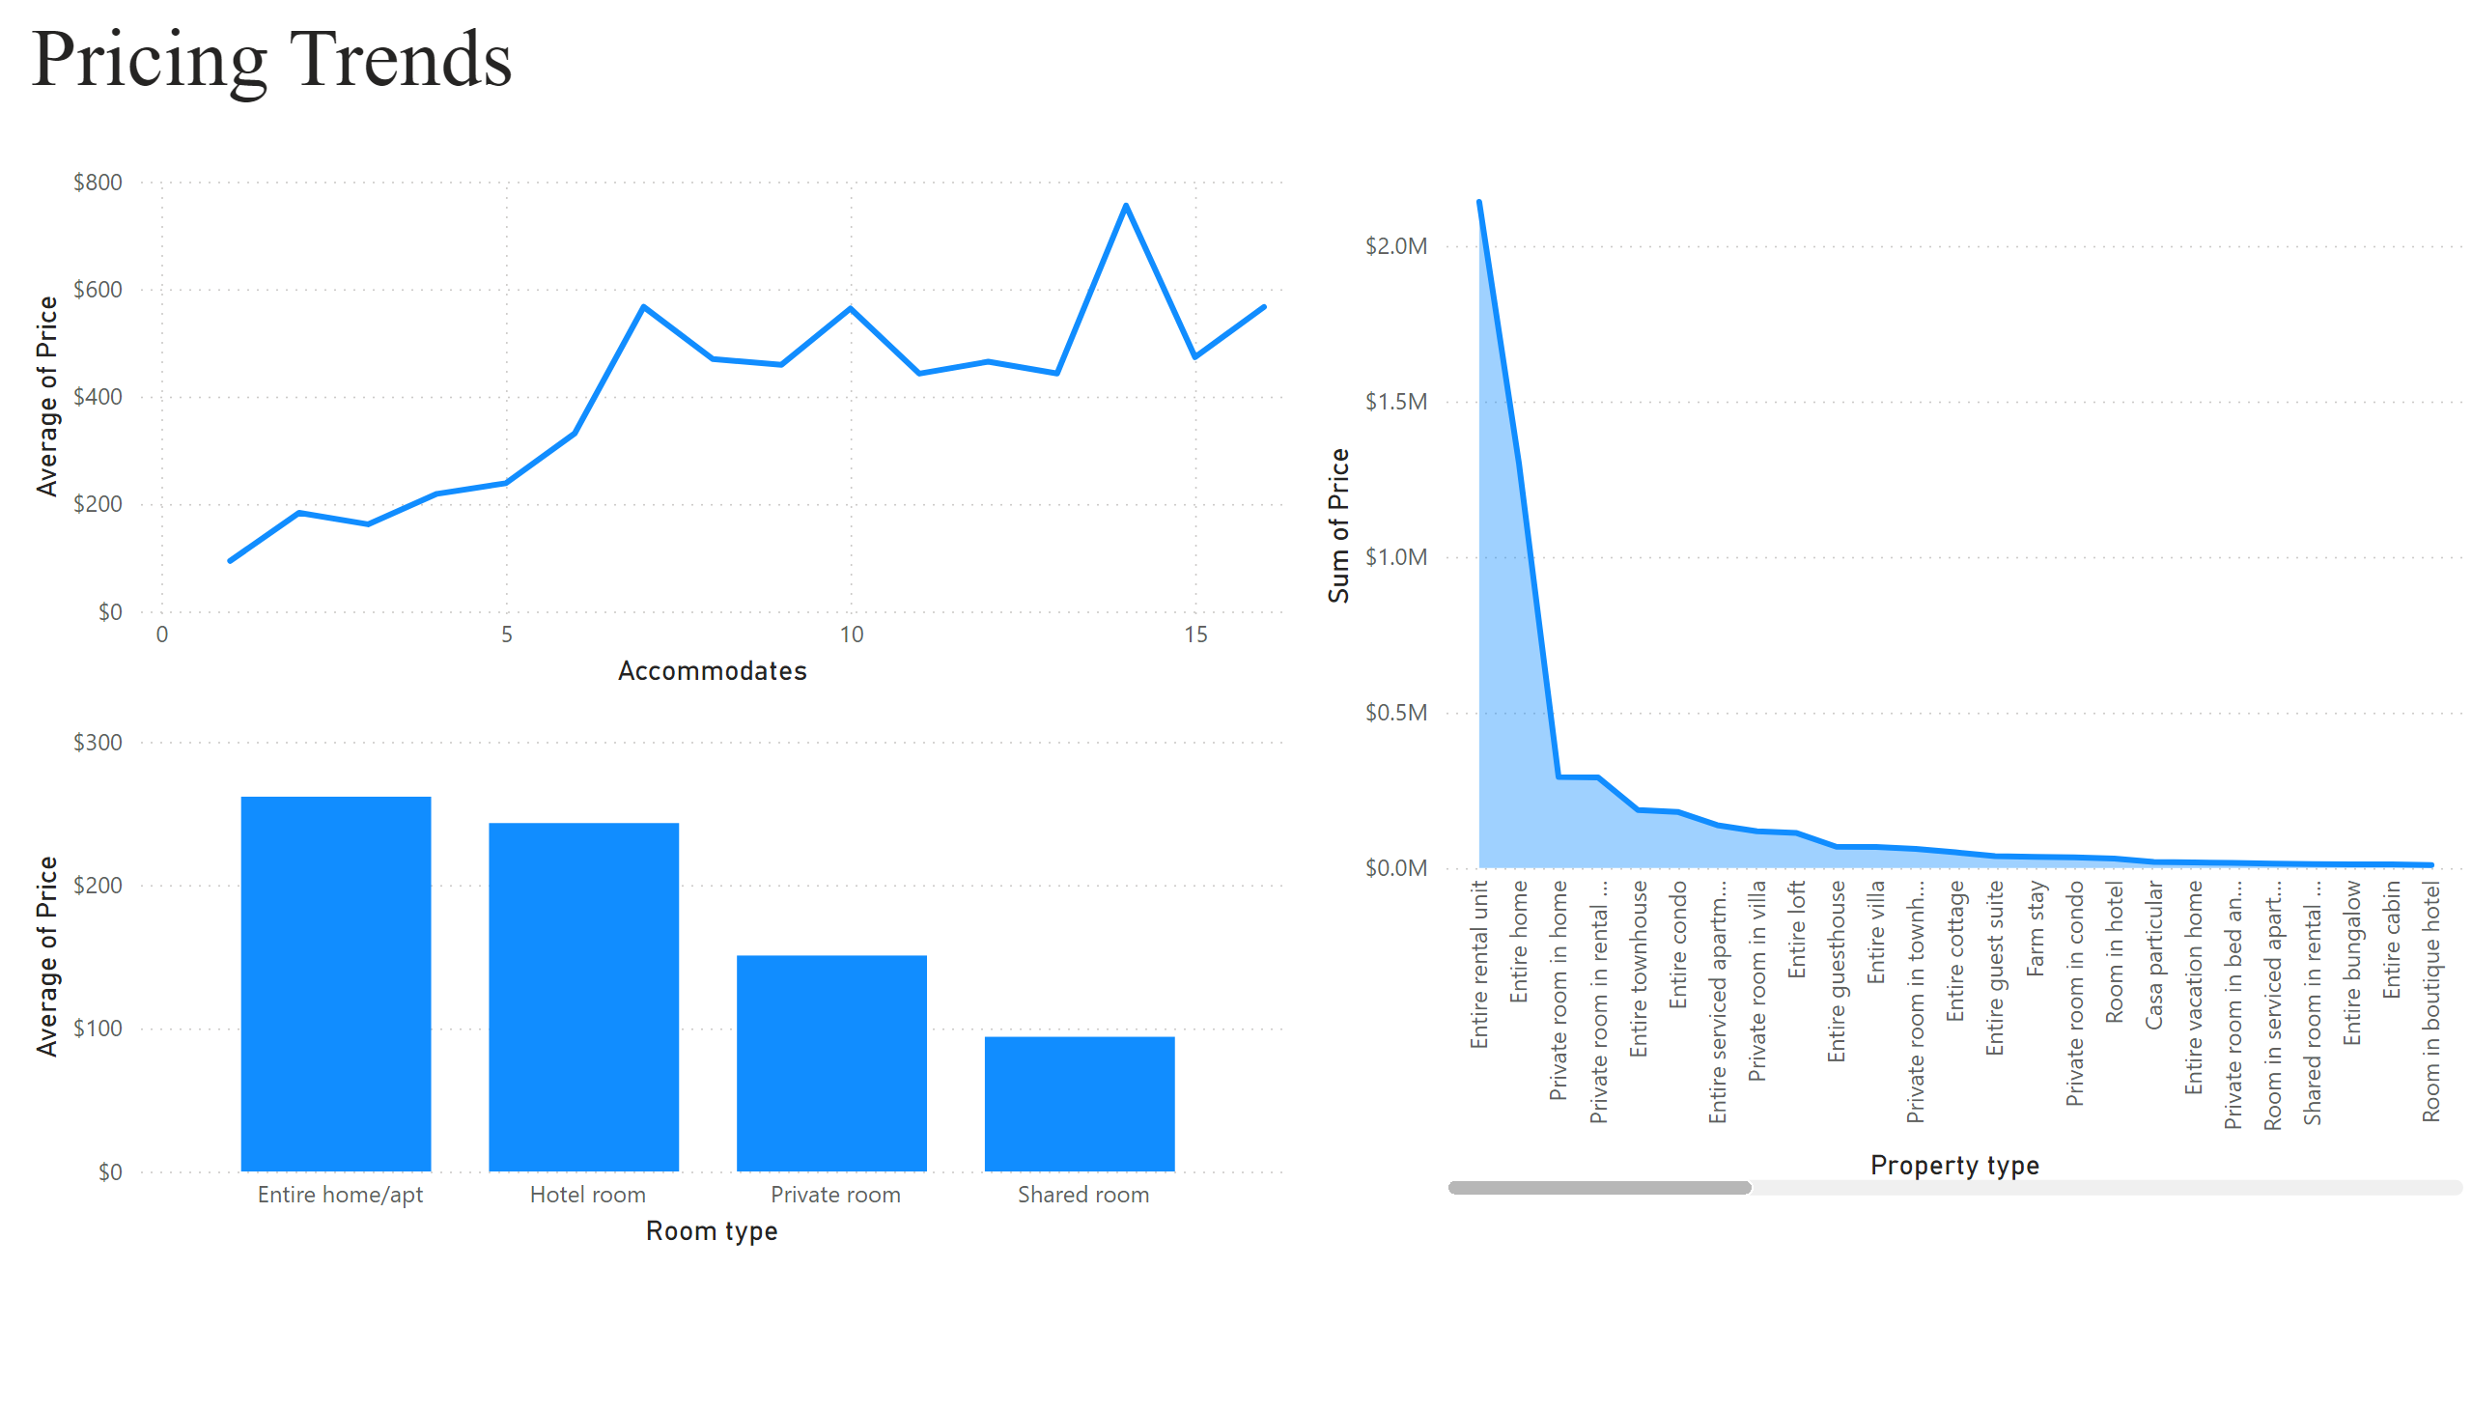
Page 2
Notes:
textbox
No alt text provided
Accommodates
No alt text provided
Room type
No alt text provided
areaChart
No alt text provided

Slide 6
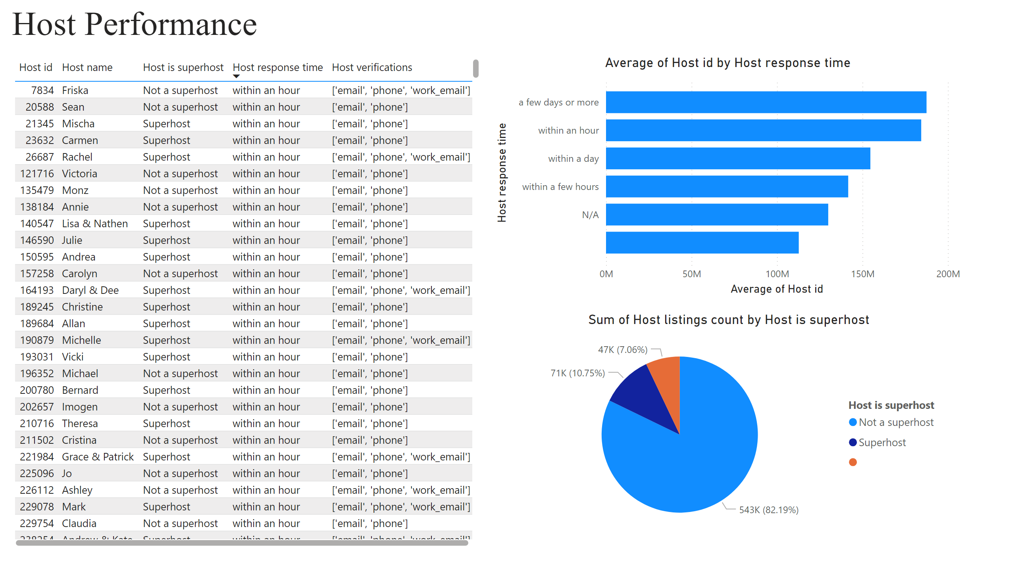
Page 3
Notes:
textbox
No alt text provided
tableEx
No alt text provided
barChart
No alt text provided
pieChart
No alt text provided

Slide 7
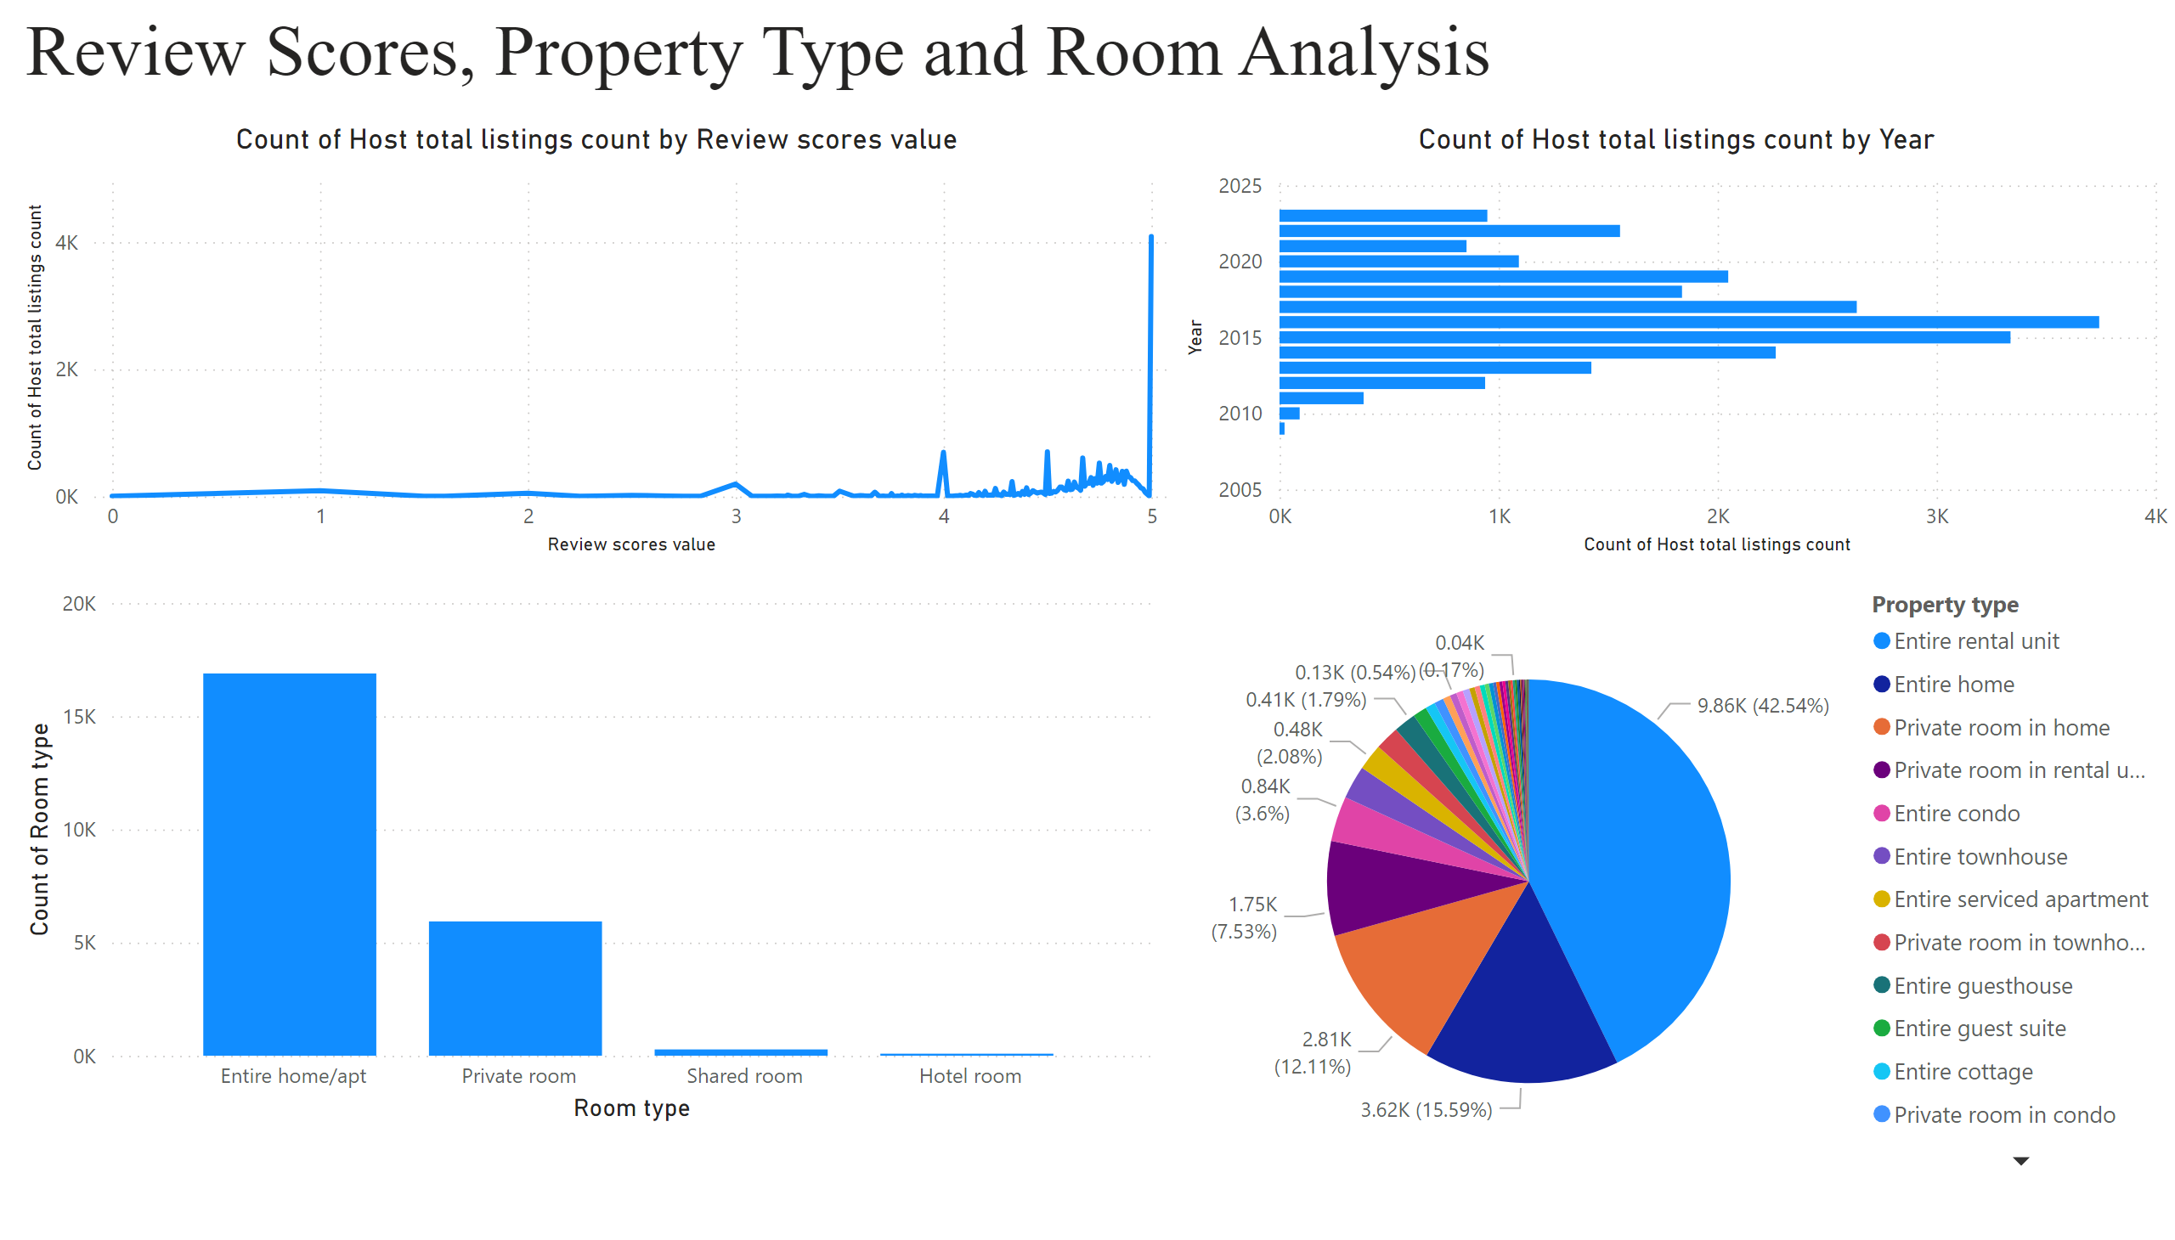
Page 4
Notes:
textbox
No alt text provided
lineChart
No alt text provided
clusteredColumnChart
No alt text provided
pieChart
No alt text provided
barChart
No alt text provided

Slide 8
Insights
Host listings count was highest for Melbourne, Australia at 6,770, followed by and Victoria, Australia.
Entire home/apt had the highest Average of Price at $261.6096, followed by Hotel room, Private room, and Shared room.
A few days or more had the highest Average of Host id and was 66.29% higher than , which had the lowest Average of Host id .
﻿Count of Host total listings count was highest for at 4,756, followed by 5 and 4.50.
Count of Host total listings count trended up, resulting in a 4,026.09% increase between 2009 and 2023.

Slide 9
THANK YOU

